Slide 2
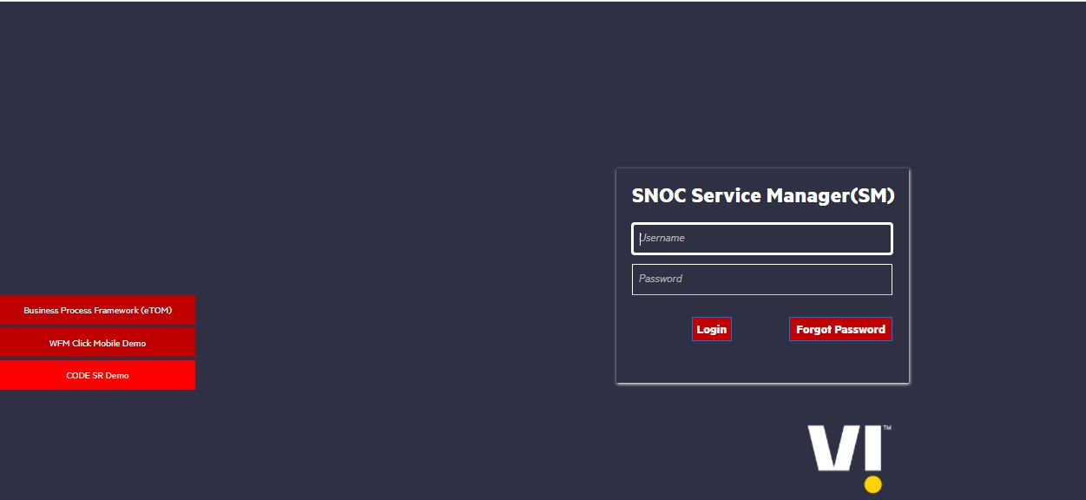
HPSM ( HP Service Manager Software )
The HP Service Manager Incident Management System manages tickets and is configured to send back events to the gateway. The Gateway for HP Service Manager uses the network record category by default.
Login URL: http://10.19.32.29:9090/SM960/index.do?lang=en

Slide 3
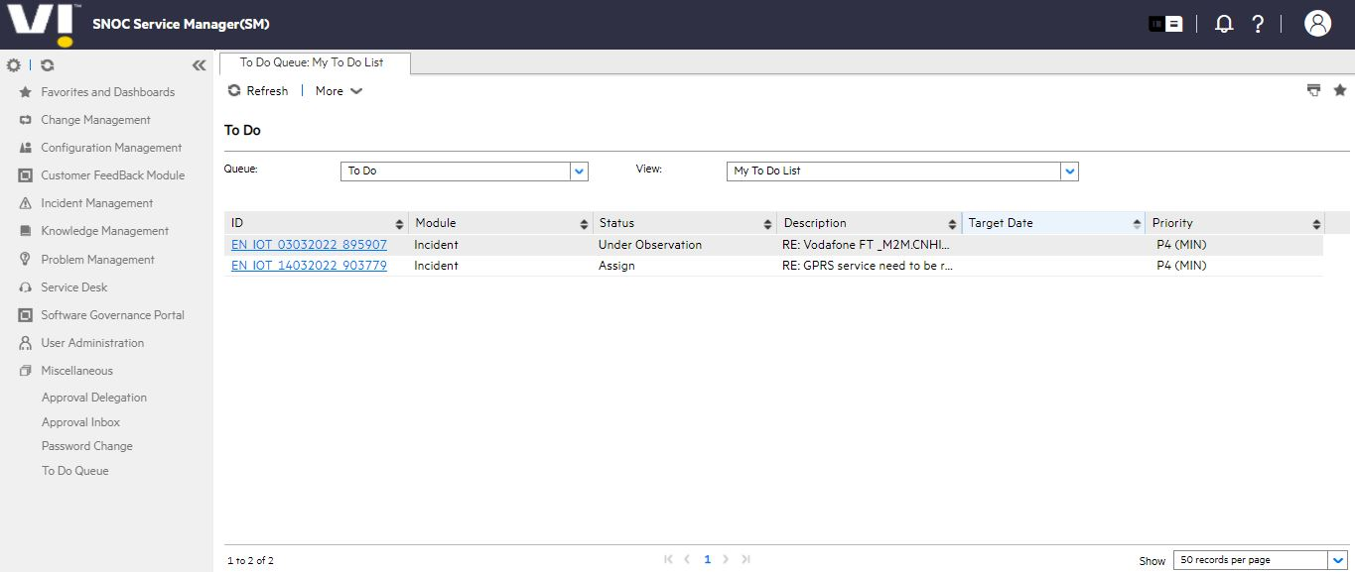
HPSM Home Page

Slide 4

CISCO Finesse
Cisco Finesse is used for making outbound call to the customer and Inbound call handle for customer query
Login URL: https://ndc3vapafin7a.inroot.in:8445/desktop/

Slide 5
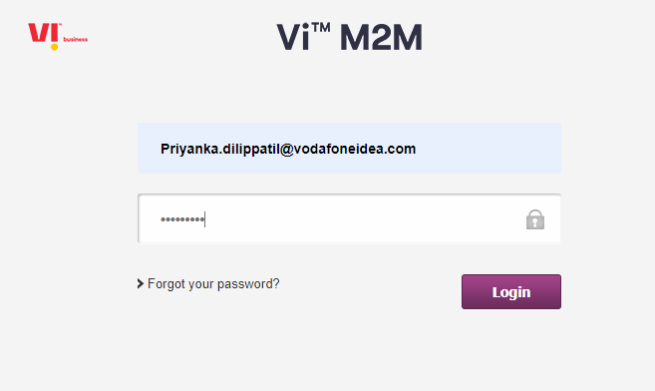
GDSP
Login URL : iotportal.myvi.in

Slide 6
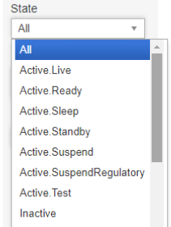
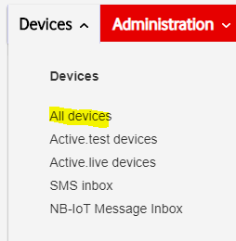
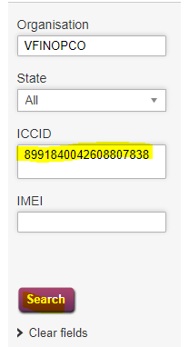

States in GDSP and Customer details
How to check customer details

Slide 7
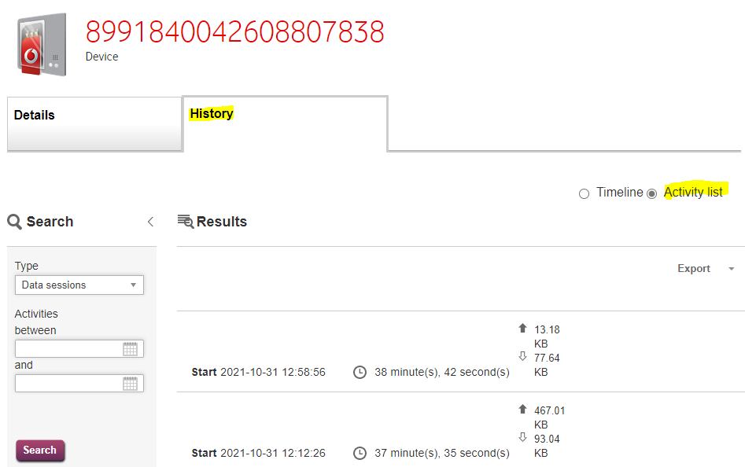
To check history of data usage

Slide 8
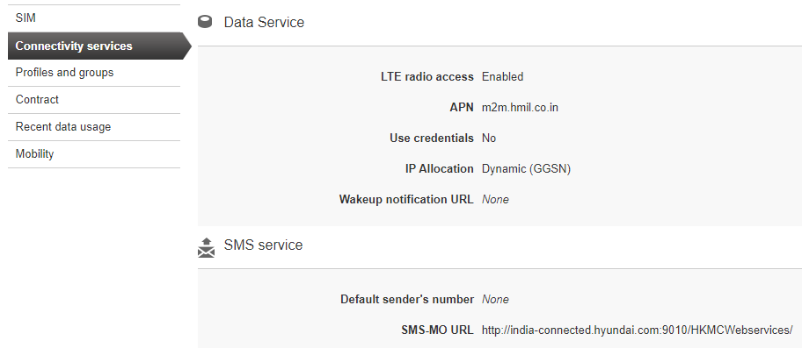
To check APN and solution type

Slide 9
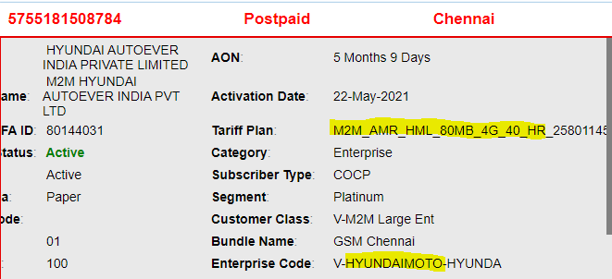
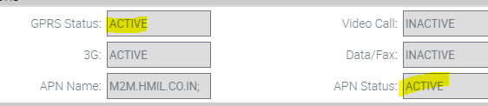
Steps to check GDSP solution.
There are two plans.
1)HR : High Rental
2)LR : Low Rental
Under High Rental(HR), sim services will be in active and it will be in below state.
Active.Live
Active.Ready
SCRM View
GDSP View

Slide 10
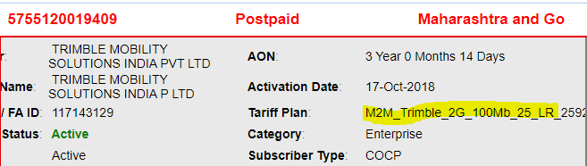
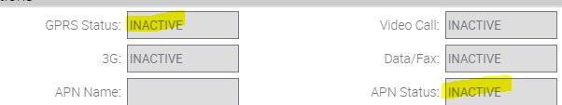

Steps to check GDSP solution.
Under Low Rental (LR), sim services will be in inactive and it will be in below state.
Active.Suspend
SCRM View
GDSP View

Slide 11
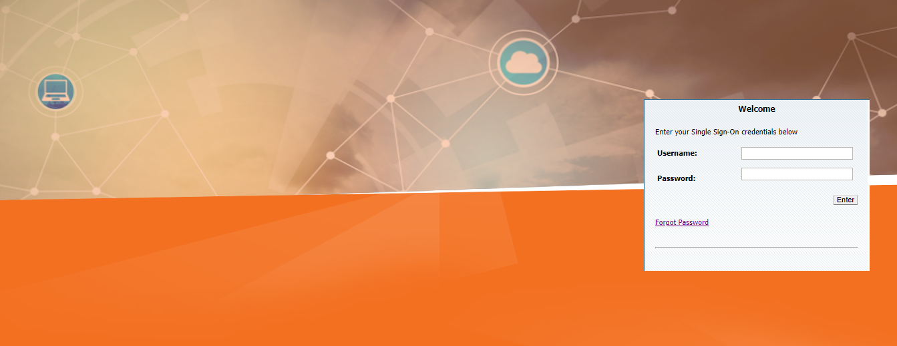
SCRM Login Page
SCRM- East : https://sumeru-east.vodafoneidea.in:6100/ecommunications_enu/start.swe?
SCRM- South : https://sumeru-south.vodafoneidea.in:6100/ecommunications_enu/start.swe?

Slide 12
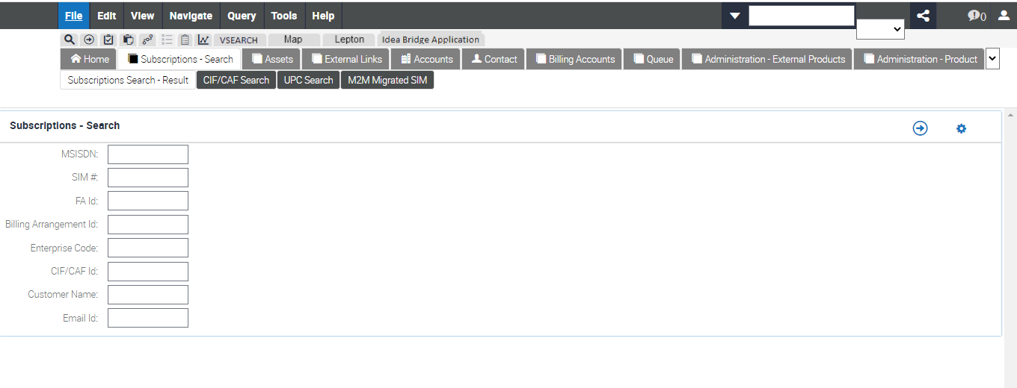
SCRM Home Page

Slide 13
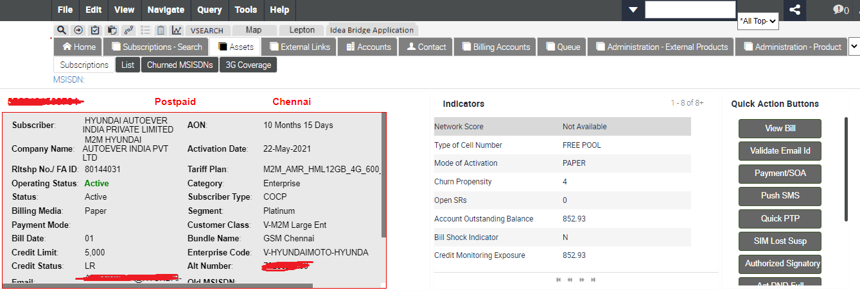
SCRM Dashboard

Slide 14
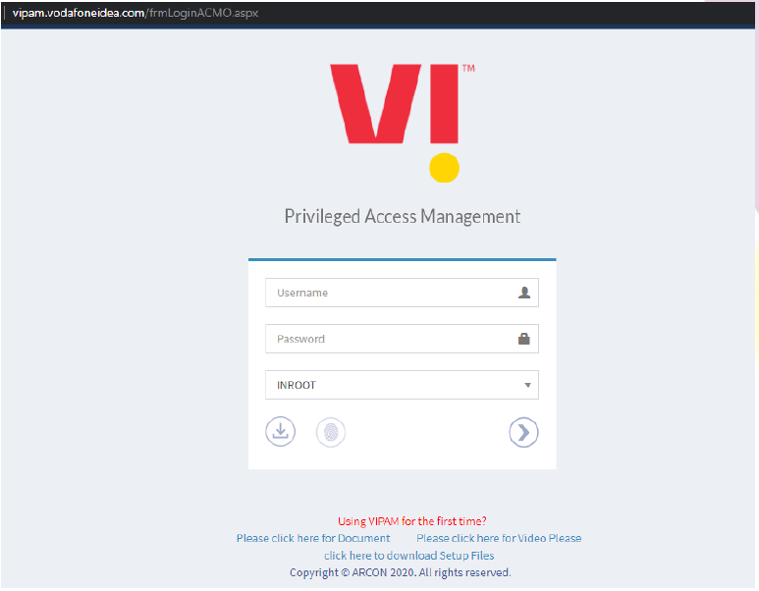
VIPAM Login Page
Login URL: https://vipam.vodafoneidea.com/frmLoginACMO.aspx
Login to application with your AD credentials.
Enter the domain ‘Username’ and ‘Password’.
Select Domain ‘INROOT’
Click on Login Button

Slide 15
VIPAM Home Page
Once you are successfully logged in you will get the below is the welcome screen:

Slide 16
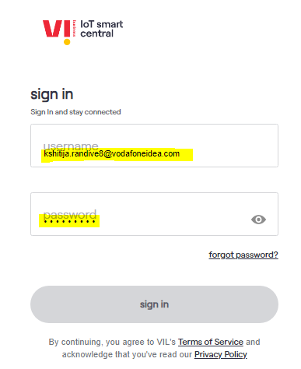
Login to your CMP portal with domain ID and Password

Slide 17
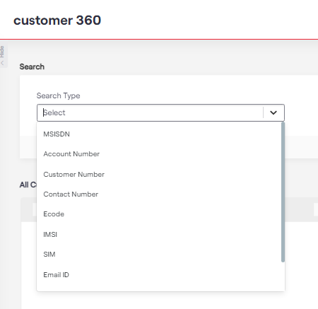
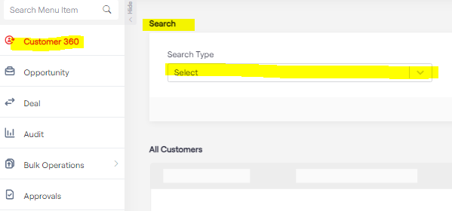
Smart Central checks
Select the search type in search box, you get below options, MSISDN, SIM number, Account Number etc.

Slide 18
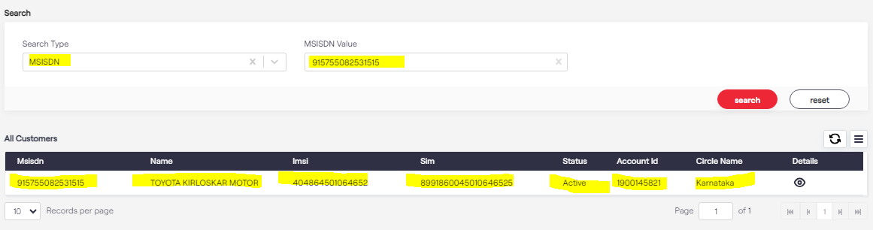
Smart Central checks
Punch the number in MSISDN value. You will fetch the details as below. Than view the details in details tab

Slide 19
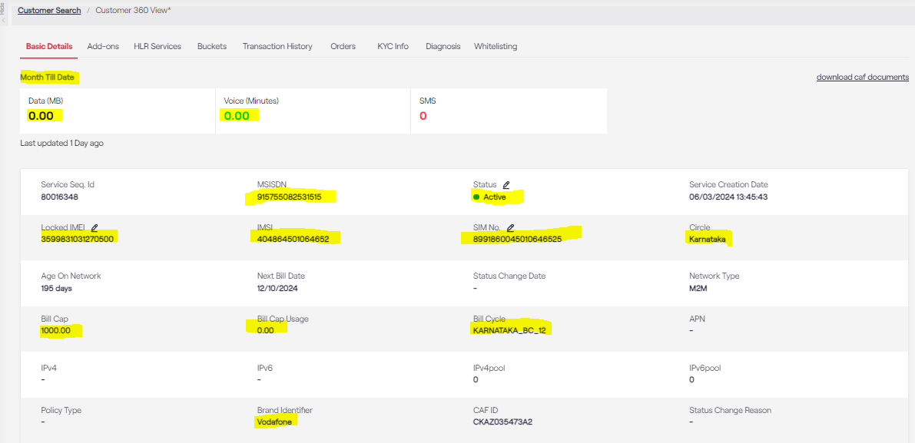
Smart Central checks
Punch the number in MSISDN value. You will fetch the details as below. Highlighted fields are mandatory.

Slide 20
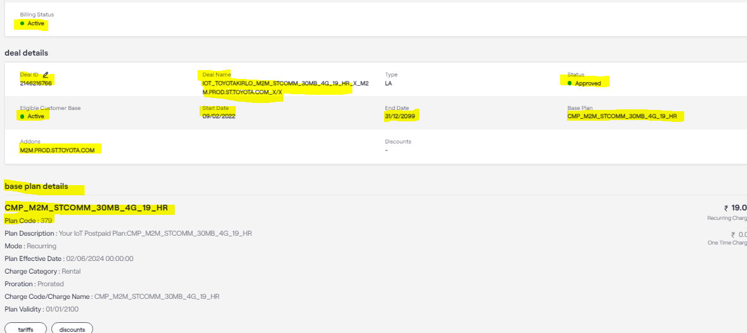
Pre-checks
Check the status of the affected number, Deal Name, APN is correct or not

Slide 21
Thank You!

